Slide 1
Cryptography
Public Key Cryptography
CSC 481/681/781
Principles of Computer Security
Notes:
asymmetric

Slide 2
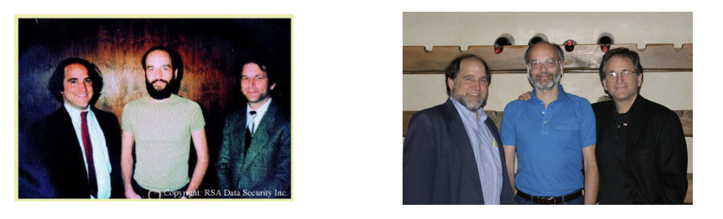
Public Key Cryptography
Diffie and Hellman published their ideas and findings in “New Directions in Cryptography” Nov ’76, together with the open problem of realizing PKC ；
Ron Rivest saw Diffie and Hellman’s paper and was intrigued by it. He enlisted the help of Shamir and Adleman, all from MIT, to work on the open problem and came up with the solution in 1977 --- this is the RSA algorithm；
Diffie, Hellman, Merkle, Rivest, Shamir, Adleman were commonly recognized as the founders of Public Key Cryptography.

Slide 3
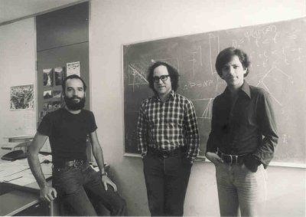
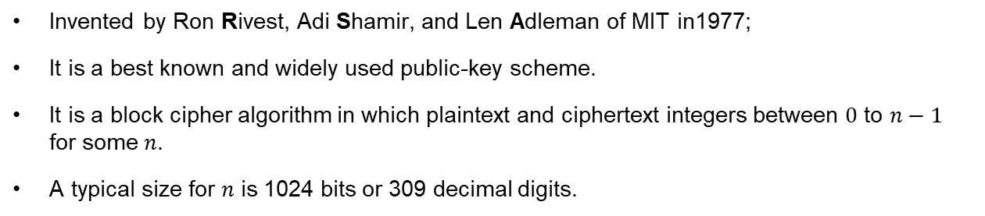
RSA
Invented by Ron Rivest, Adi Shamir, and Len Adleman of MIT in1977;
It is a best known and widely used public-key scheme.
It is a block cipher algorithm in which plaintext and ciphertext integers between $0$ to $n−1$ for some $n$.
A typical size for $n$ is 1024 bits or 309 decimal digits.

Slide 4
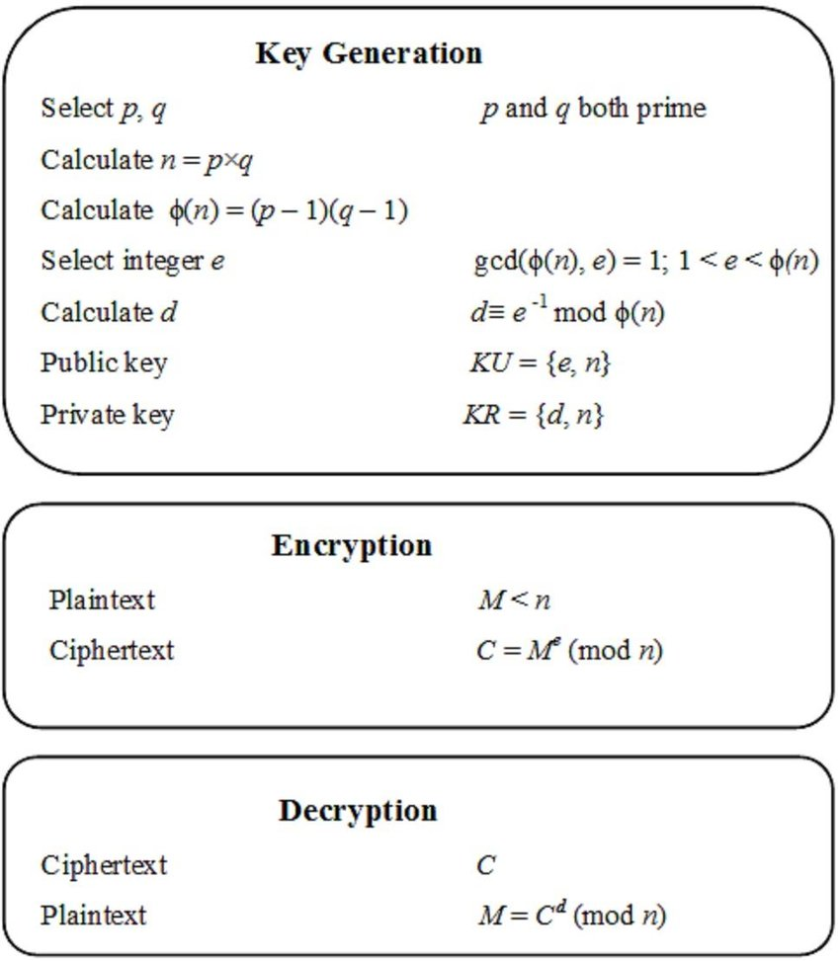
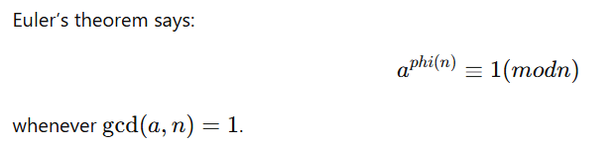


RSA
e is relatively prime to $Φ(n)$
RSA achieves $D\left[E\left[m\right]\right]=m=E[D[m]]$

Slide 5
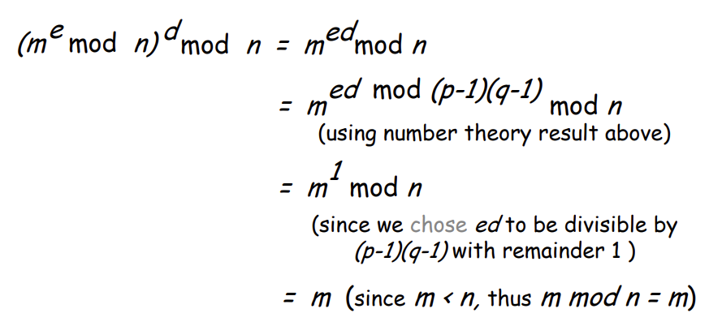

RSA
RSA achieves $D\left[E\left[m\right]\right]=m=E[D[m]]$
Why?
Useful number theory result: If $p,q$ prime and $n=pq$, then we have:
$$x^{y}mod n=x^{y mod (p−1)(q−1)} mod n$$

Slide 6
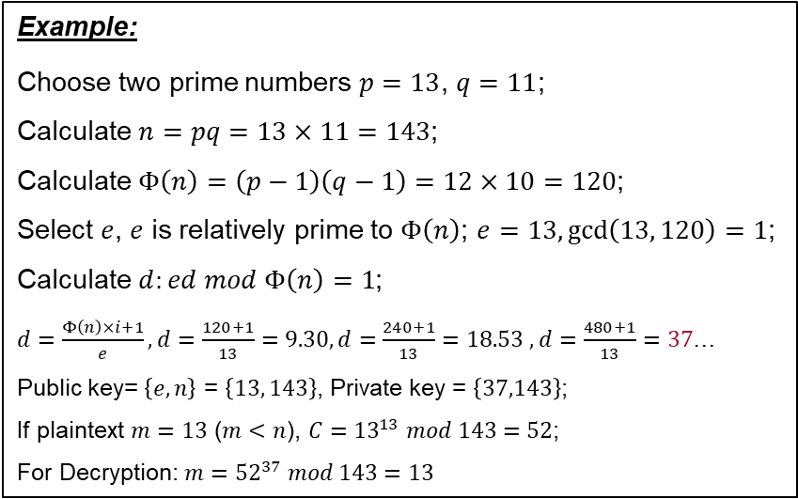
RSA
Example:
Choose two prime numbers $p=13$, $q=11$;
Calculate $n=pq=13×11=143$;
Calculate $Φ\left(n\right)=\left(p−1\right)\left(q−1\right)=12×10=120$;
Select $e$, $e$ is relatively prime to $Φ\left(n\right)$; $e=13,\gcd\left(13, 120\right)=1$;
Calculate $d:ed mod Φ\left(n\right)=1$;
$d=\frac{Φ\left(n\right)×i+1}{e}, d=\frac{120+1}{13}=9.30, d=\frac{240+1}{13}=18.53$ $, d=\frac{480+1}{13}=37$…
Public key= $\left\{e,n\right\}$ = $\left\{13, 143\right\}$, Private key = $\left\{37,143\right\}$;
If plaintext $m=13$ ($m<n$), $C={13}^{13} mod 143=52$;
For Decryption: $m={52}^{37} mod 143=13$

Slide 7
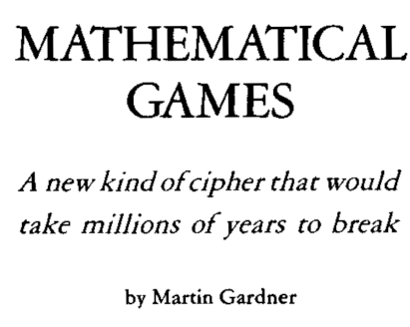
RSA
Martin Gardner publishes Scientific American column about RSA in August 1977, including the RSA $100 challenge (129 digit , or about 430-bit n );
RSA-129 = 114,381,625,757,888,867,669,235,779,976,146,612,010,218,296, 721,242,362,562,561,842,935,706,935,245,733,897,830,597,123, 563,958,705,058,989,075,147,599,290,026,879,543,541 (129 digits)
or to decode encrypted message.
RSA-129 was factored in 1994, using thousands of computers on Internet, using 5000 MIPS-years (1GHz Pentium PC ~= 250 MIPS) “THE MAGIC WORDS ARE SQUEAMISH OSSIFRAGE”
Gives credibility to difficulty of factoring and helps establish key sizes needed for security.

Slide 8
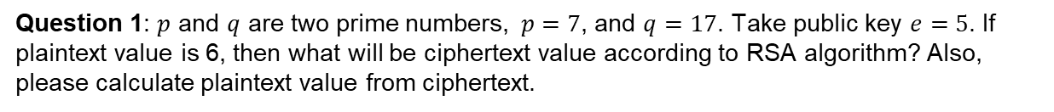
RSA
Test your understanding
Question 1: $p$ and $q$ are two prime numbers, $p=7$, and $q=17$. Take public key $e=5$. If plaintext value is 6, then what will be ciphertext value according to RSA algorithm? Also, please calculate plaintext value from ciphertext.

Slide 9
RSA
Test your understanding
Question 2: In a public key cryptosystem using RSA algorithm, user uses two prime numbers 5 and 7. He chooses 11 as Encryption key, find out decryption key. What will be the ciphertext, if the plaintext is 2? Decrypt the ciphertext, what will be the value of plaintext?

Slide 10


Basics of Encryption
Confidentiality Protection for Messages
aGxU4N<:1EvxxYEL4}0h7dP6]%<
Network
Interface
Network
Interface
Plaintext: The message the sender wants to send.
Ciphertext: The data that is transmitted.
Goal: Ciphertext should reveal no information about plaintext to anyone who doesn’t have the decryption key (semantic security).
Encryption
Function
Decryption
Function
Pay with
1234 5678 9012 3456
Pay with
1234 5678 9012 3456

Slide 11

Basics of Encryption
Confidentiality Protection for Messages
?
aGxU4N<:1EvxxYEL4}0h7dP6]%<
aGxU4N<:1EvxxYEL4}0h7dP6]%<
Network
Interface
Network
Interface
Plaintext: The message the sender wants to send.
Ciphertext: The data that is transmitted.
Goal: Ciphertext should reveal no information about plaintext to anyone who doesn’t have the decryption key (semantic security).
OR: Ciphertext can’t be tampered with in a meaningful way (non-malleable security).
Encryption
Function
Decryption
Function
Pay with
1234 5678 9012 3456
Pay with
1234 5678 9012 3456

Slide 12
Basics of Encryption
What’s necessary for security?
aGxU4N<:1EvxxYEL4}0h7dP6]%<
Let’s simplify the goal to:
Passive attacker can’t discover plaintext
Ask: What does attacker know?
Decryption
Function
Pay with
1234 5678 9012 3456

Slide 13
Basics of Encryption
What’s necessary for security?
Attacker knows...
aGxU4N<:1EvxxYEL4}0h7dP6]%<
Let’s simplify the goal to:
Passive attacker can’t discover plaintext
Ask: What does attacker know?
Decryption
Function
Pay with
1234 5678 9012 3456

Slide 14
Basics of Encryption
What’s necessary for security?
Attacker knows...
aGxU4N<:1EvxxYEL4}0h7dP6]%<
Let’s simplify the goal to:
Passive attacker can’t discover plaintext
Ask: What does attacker know?
Decryption
Function
So this must be secret!
Pay with
1234 5678 9012 3456

Slide 15
Basics of Encryption
What’s necessary for security? The other side of the model
aGxU4N<:1EvxxYEL4}0h7dP6]%<
Attacker knows...
Does Encryption Key need to be secret?
Encryption
Function
Pay with
1234 5678 9012 3456

Slide 16
Basics of Encryption
What’s necessary for security? The other side of the model
aGxU4N<:1EvxxYEL4}0h7dP6]%<
Attacker knows...
Does Encryption Key need to be secret?
Answer: Not necessarily!!!
One of the most important breakthroughs of early computer science (late 60s / early 70s):
Developed time complexity models
NP-completeness suggests some functions may be easy to compute, but hard to invert (one-way function)
Trapdoor functions: Function hard to compute, but becomes easy with extra info
Encryption
Function
Pay with
1234 5678 9012 3456

Slide 17
Basics of Encryption
Traditional (pre-1970) crypto – symmetric ciphers
aGxU4N<:1EvxxYEL4}0h7dP6]%<
Network
Interface
Network
Interface
Keys the same or different?
The same: “Symmetric cipher”
Some algorithms: DES, AES, Blowfish, RC4 (probably best to avoid…)
Best feature: fast!
(AES-NI gives 5-10 Gbps)
Worst feature: difficult key management.
Encryption
Function
Decryption
Function
Pay with
1234 5678 9012 3456
Pay with
1234 5678 9012 3456

Slide 18
Basics of Encryption
Modern crypto - public-key cryptography
aGxU4N<:1EvxxYEL4}0h7dP6]%<
Network
Interface
Network
Interface
Keys the same or different?
Different: “Public-key crypto”
Some algorithms: RSA, ElGamal, ECC, …
Best feature: Simpler key management (can send to a stranger!)
Worst feature: Slow (1-2 Mbps for 2048-bit RSA - others are a little faster…)
Encryption
Function
Decryption
Function
Pay with
1234 5678 9012 3456
Pay with
1234 5678 9012 3456

Slide 19
Basics of Encryption
Comparison: Symmetric vs. Public-Key
Symmetric Ciphers
Fast!!! Up to 1000x faster than PK
(Seem to) require brute force to break
Must have shared secret (key mgmt)
Public-Key Encryption
Communicate with strangers (key mgmt)
Slow (100-1000 times slower)
Mathematical breaks (larger keys req’d)
Attacks on good symmetric ciphers use brute-force
Try all keys to see which give “sensible plaintext”
Complexity: k-bit key requires on average ½ 2^{k} trials
Unicity distance: How much ciphertext is needed before we expect a single “sensible plaintext” (closely related to entropy)
Surprisingly short: 38 characters for English and AES-256
Can increase (a lot!) by compressing plaintext
Public key relies on “math tricks” and short keys can be broken by “math tricks”
Example: Factoring breaks RSA
Consequence: Need larger keys for security (but PK is secure with larger keys!)

Slide 20
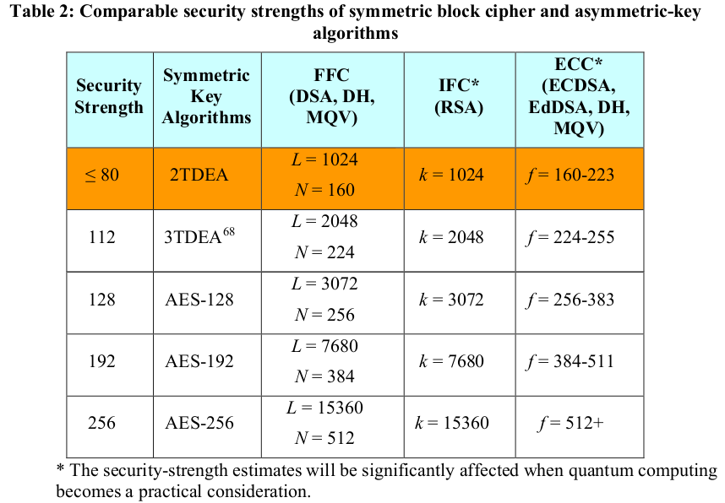
Basics of Encryption
Comparable key sizes
From NIST publication 800-57, part 1, rev 5 (May 4, 2020)

Slide 21
Basics of Encryption
Final idea: Hybrid encryption
Receiver’s Public Key
Public-Key Encryption
Random “session key”
Encrypted “session key”
Message (maybe big!)
Ciphertext (message)
T1GYJIUPXpVHg9zVMcY2/dK/fsv+Z6rdPUqPKJVASDRQCDoLeKa9IJRh2uIdjGO6N3/haJ3hXKgqy9ysLRjH0svOnuGB540bTtlrsdVI4GQDYtJlVo3K1I2kprqQZlcYzxBV9K++v9lMmMLlxz….
Symmetric Cipher
Hybrid Encryption
Communicate with strangers (key mgmt)
Fast for message (even if huge)
Mathematical breaks (larger keys req’d)
Complicates code (using two algorithms)

Slide 22
Public-Key Cryptography Standards (PKCS)
PKCS (Public-Key Cryptography Standards) is a set of widely used specifications developed by RSA Laboratories starting in the early 1990s. The goal of PKCS is to standardize how public-key cryptography is implemented, including:
Key generation
Key storage
Digital signatures
Encryption/decryption
Certificate requests (CSR)
Cryptographic message syntax (CMS)
Token interfaces (smart cards)
PKCS | Description
#1 | RSA standard, OAEP, PSS
#3 | Diffie-Hellman key exchange
#5 | Password-based encryption (PBKDF2)
#7 | Cryptographic message syntax (CMS / S/MIME)
#8 | Private key storage format
#10 | Certificate Signing Request (CSR)
#11 | Token interface (smartcards/HSMs)
#12 | Personal key/cert file format (PFX/P12)

Slide 23
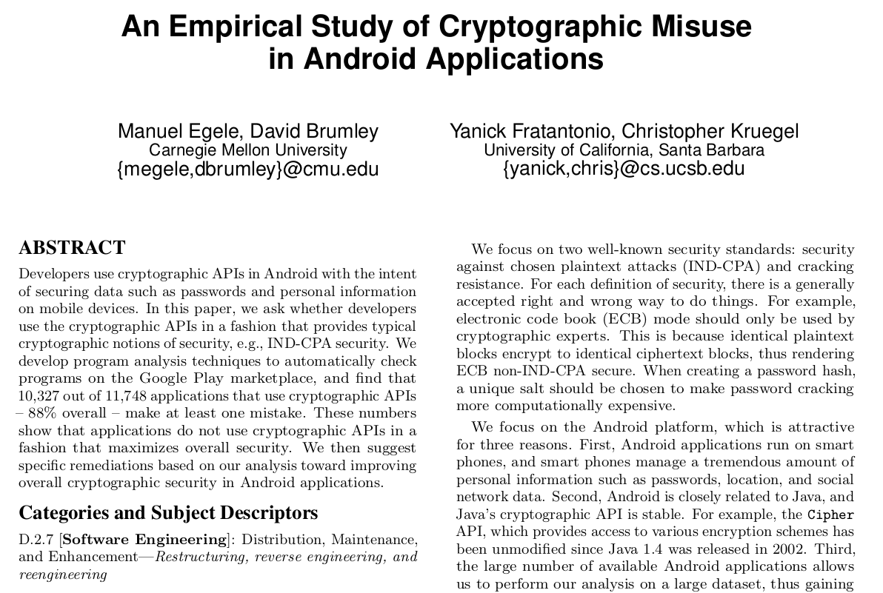
Use of Cryptography in Practice
Do people use crypto properly?
Link

Slide 24
Use of Cryptography in Practice
Do people use crypto properly?
Common Implementation Mistakes:
Reusing a One-Time Pad Key
Weak Random Number Generators (RNG) Causing Predictable Keys (OpenSSL: RNG always seeded with PID → 4k possible keys)
Timing Attacks Due to Non-Constant-Time Code (e.g., measure response time to recover bits of the key)
Insecure Storage of Private Keys (e.g., store keys in plaintext file or code positories)
Side-Channel Attacks on Hardware (e.g., power consumption, cache usage)

Slide 25
Using Cryptography in Your Code
Hard and fast rule: Don’t implement your own cryptographic routines
Many popular, well-vetted libraries available on all platforms:
Microsoft Cryptographic API (CryptoAPI) on Windows
OpenSSL/LibreSSL/LibCrypto on Linux/Unix variants (incl Apple)
Java Cryptographic Architecture in Java (and Android)
NaCl (“Networking and Cryptography library” - “salt”) and libsodium

